Slide 1

ITP - Chapter 6
西南林业大学
International Payment
Page 88-117

Slide 2
Clearing the Ground
(What does this chapter aim to?)
This chapter aims to explain the different types of payment methods used in international transactions.

Slide 3
Clearing the Ground
Reference:
《国际贸易实务》（第六版）对外经济贸易大学出版社，2017年1月
第八章 国际货款的收付
Page 151-190

Slide 4
Section 1 – Payment Options
The four basic methods of payment:
Payment in advance,
Documentary (letter of) credit,
Documentary collections,
Open account

Slide 5
Section 1 – Payment Options
1. Payment in advance
The buyer simply prepays the seller prior to shipment of the goods. It provides the seller with the most security but leaves the buyer at great risk.

Slide 6

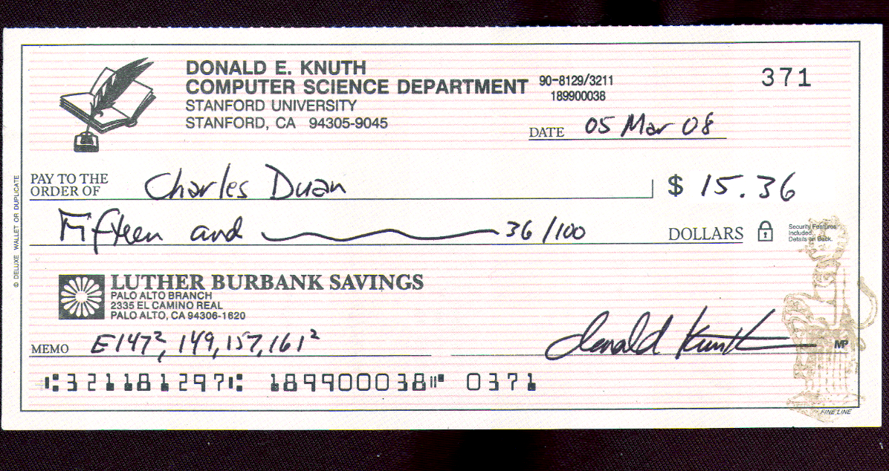
Section 1 – Payment Options
1. Payment in advance
Cash in advance is usually a wire transfer or a check.

Slide 7
Section 1 – Payment Options
1. Payment in advance
Although an international wire transfer is more costly, it is often preferred because it is speedy and does not bear the danger of the check not being honored. The check can be a disadvantage if the exchange rate has changed significantly by the time it arrives, clears and is credited. For wire transfers the seller must provide clear routing instructions in writing to the buyer or the buyer’s agent.

Slide 8
Section 1 – Payment Options
1. Payment in advance
Remittance is an act of transmitting money, bills, or the like, to a distant place, as in satisfaction of a demand, or in discharge of an obligation.

Slide 9
Section 1 – Payment Options
1. Payment in advance
There are three types of remittance: (1) Mail Transfer (M/T), (2) Telegraph Transfer (T/T), (3) Demand Draft (D/D).

Slide 10
Section 1 – Payment Options
1. Payment in advance
The payer instructs his bank or other institutions to have a payment made to the payee. Four parties are involved in the remittance process: the remitter, the payee, the remitting bank and the paying bank.

Slide 11
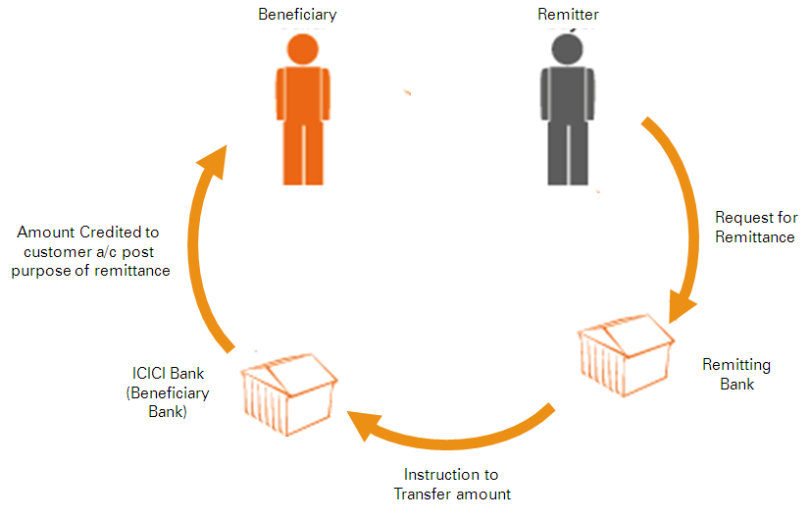

Section 1 – Payment Options
1. Payment in advance
Payee
Sales Contract
Order to Pay
Paying Bank

Slide 12
Section 1 – Payment Options
2. Documentary (Letters of) Credit
A letter of credit is a bank’s commitment to pay the seller a specified sum on behalf of the buyer under precisely defined conditions. Letters of credit are the most common form of international payment because they provide a high degree of protection for both the buyer and the seller.

Slide 13
Section 1 – Payment Options
3. Documentary Collections
A documentary collection is similar to an international cash on delivery (COD). The seller ships the goods to the buyer but sends the documents, including the bill of lading (title document), through the banks with instructions to release them to the buyer only upon payment. When the buyer obtains the title documents, he has the right to take ownership of the shipment.

Slide 14
Section 1 – Payment Options
3. Documentary Collections
Letters of credit belong to “banker’s credit”. Remittance and collection belong to “commercial credit”. The buyer is responsible for making payment, the seller handing over documents.

Slide 15
Section 1 – Payment Options
4. Open Accounts
The buyer agree to pay for the goods within a designated time after the shipment, usually in 30, 60, or 90 days. Open account terms provide with the buyer with the greatest security and flexibility but lease the seller at greatest risk.

Slide 16
Section 1 – Payment Options
5. Hybrid Methods (Extension)
In practice, international payment methods tend to be quite flexible and varied. Frequently, trading partners will use a combination of payment methods. For example, the seller may require that 50% payment be made in advance using a wire transfer and that the remaining 50% be made by documentary collection.

Slide 17
Section 1 – Payment Options
6. Other Payment Methods (Extension)
Consignment method （寄售方式）
The consignment method requires that the seller ship the goods to the buyer, broker or distributor but not receive payment until the goods are sold or transferred to another buyer. Although this is the riskiest sort of transaction, it is nonetheless common in the trade of fresh produce.

Slide 18
Section 1 – Payment Options
6. Other Payment Methods (Extension)
（2）Countertrade （对等贸易）
Countertrade is a general name given to a variety of activities to promote trade with nations that are short of convertible currency. The basic activity is similar to barter – the exchange of goods for goods – but today it is more sophisticated than that. In a trade of barter the parties must each have what the other wants and what the other has. The following types of countertrade have been identified: compensation trad, counter-purchase, buy-back, offset, switch, triangular deals, and so on.

Slide 19
Section 2 – Bills of Exchange
1. Definition
The bill of exchange is a specialized type of negotiable instrument commonly used to expedite foreign money payments in many types of international transactions. It acts as a substitute for money, and a financing or credit device.

Slide 20
Section 2 – Bills of Exchange
1. Definition
A bill of exchange is a written instrument which contains an unconditional order whereby the drawer directs the drawee to pay a definite sum of money to the payee or to his order on demand or at a definite time.

Slide 21
Section 2 – Bills of Exchange
1. Definition
A bill of exchange is often called a draft, or international draft. The term “bill of exchange” is frequently used in England, while the word “draft” is more frequently used in US law and banking practices.

Slide 22
Section 2 – Bills of Exchange
2. Parties Involved
Basically three parties: (1) drawer, (2) drawee, and (3) payee.
Other parties: acceptor, endorser, endorsee, bearer, etc.

Slide 23
Section 2 – Bills of Exchange
3. Types of Bills of Exchange
According to the tenor, there are time and sight bills.

Slide 24
Section 2 – Bills of Exchange
3. Types of Bills of Exchange
According to the acceptors, there are trade acceptance and banker’s acceptance.

Slide 25
Section 2 – Bills of Exchange
3. Types of Bills of Exchange
An acceptance is a time draft that has been accepted and signed by the drawee (the buyer or the bank) for payment at maturity.
(Case 6-1)

Slide 26
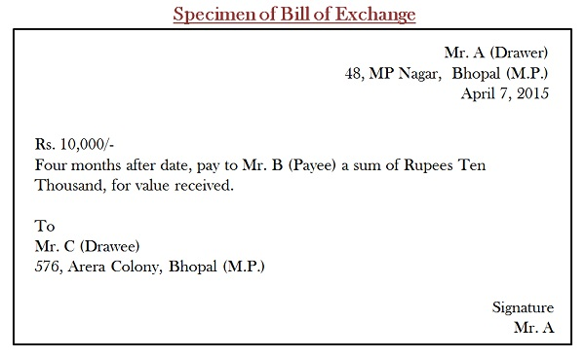
Section 2 – Bills of Exchange
3. Types of Bills of Exchange

Slide 27

Section 2 – Bills of Exchange
4. Checks
When the drawee of a bill of exchange is a bank, the bill is known as a check. Checks are always payable on demand.
(Case 6-2) (Video 1 & 2)

Slide 28
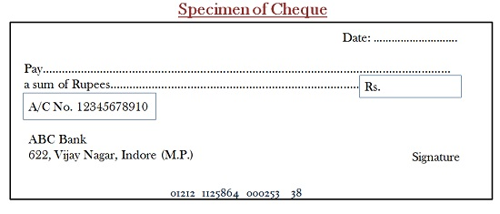
Section 2 – Bills of Exchange
4. Checks
Similarities between bills of exchange and checks:
They are Negotiable Instrument.
Addressing the drawee to make payment.
Always in writing.
Signed by the drawer of the instrument.
Express order to pay a certain amount.

Slide 29
Section 2 – Bills of Exchange
4. Checks
Difference between bills of exchange and checks:
‘Cheque‘ is an instrument which contains an unconditional order, drawn on a banker, directing to pay a certain sum of money to the person whose name is specified in the instrument.
In contrast, ‘Bill of Exchange‘ is a document contains an unconditional order, directing a person, to pay a certain amount to a specified person.

Slide 30
Section 2 – Bills of Exchange
4. Checks
Difference between bills of exchange and checks:
Cheque and Bill of Exchange both are used to make payments easily. However, the cheque itself is a type of bill of exchange, used to discharge the liabilities and so it consists of all the features of a bill of exchange. Not only in business, but individuals, government agencies, and other institutions also use the cheque to make payments but the bill of exchange is mostly used in business.

Slide 31
Section 2 – Bills of Exchange
4. Checks

Slide 32
Section 2 – Bills of Exchange
5. Promissory Notes
A promissory note is an instrument written and issued by a drawer, promising to pay unconditionally a fixed amount of money to a payee or holder at the sight of the instrument.

Slide 33
Section 2 – Bills of Exchange
5. Promissory Notes
The difference between a promissory note and a bill of exchange is that the maker of a note promises to personally pay the payee rather than ordering a third party to do so.

Slide 34
Section 2 – Bills of Exchange
6. Governing Laws
Bills of Exchange Act in Britain and its former colonies, such as Canada.
The Geneva Conventions:
Convention Providing a Uniform Law for Bills of Exchange and Promissory Notes, 1930
Convention Providing a Uniform Law for Cheques, 1931

Slide 35
Section 2 – Bills of Exchange
6. Governing Laws
(3)United Nations:
UNCITRAL Convention on International Bills of Exchange and International Promissory Notes, 1998
(Case 6-3)

Slide 36
Section 3 – Documentary Collections
Documentary Collection in General
A documentary collection (D/C) is so-called because the exporter receives payment from the importer in exchange for the shipping documents, with the funds and documents channeled through their respective banks. Shipping documents, just to be clear, are documents required for the buyer to clear customs and take delivery of goods—commercial invoice, certificate of origin, insurance certificate, packing list, etc.

Slide 37
Section 3 – Documentary Collections
Documentary Collection in General
The roles and responsibilities of the banks in the collection process are laid down in the International Chamber of Commerce publication, Uniform Rules for Collection (URC 522). These rules are private rules, and should be specifically invoked by express incorporation into the collection order.

Slide 38
Section 3 – Documentary Collections
1. Parties Involved in a Documentary Collection
There are four main parties to a documentary collection transaction. Each party may have several names.
The principal: drawer/seller/exporter
The remitting bank: principal’s bank
The collecting or representing bank: buyer’s bank
The drawee: buyer/importer

Slide 39
Section 3 – Documentary Collections
2. Basic Documentary Collection Procedures
A key document in documentary collections is the bill of exchange or draft, which is a formal demand for payment from the exporter to importer. The seller usually uses a local bank (remitting bank) to transmit the documents and draft through its corresponding relations to the buyer’s bank (collecting bank). Once the collecting bank has presented the documents for collection, the remitting bank must be informed of the outcome, regardless of whether the importer makes or refuses acceptance or payment. This “advice of fate” should be sent immediately to the remitting bank, which will then inform the exporter of the position.
(Case 6-4)

Slide 40

Case 18 (6-4)
Winemaker v. Bank
The collecting bank (Brooksfield) failed to inform the German winemaker (Rheinberg) of the American importer’s (J&J Wine) failure to pay. So the bank was responsible for the consequences.

Slide 41
Section 3 – Documentary Collections
3. Types of Collection
According to whether documents are included: (1) clean collection or (2) documentary collections.
According to the tenor of the draft: (1) documents against payment (D/P) 付款交单, or (2) documents against acceptance (D/A) 承兑交单.

Slide 42
Section 3 – Documentary Collections
3. Types of Collection
Documentary collections (D/Cs) can be classified into two types, depending on when payment is sought by the exporter: 1) documents against payment (D/P), which requires the importer to pay the face amount of the draft at sight, or 2) documents against acceptance (D/A), which requires the importer to pay on a specified future date.
The exporter’s risk is obviously higher in the D/A collection process, since the exporter has no control over the goods after the importer’s acceptance and may not get paid for them.

Slide 43
Section 3 – Documentary Collections
4. Collection Order
The collection order is the key document prepared by the seller specifying the terms and conditions of the documentary collection.
(Figure 6-11 Sample Collection Order)

Slide 44
Section 3 – Documentary Collections
5. Comments on D/C (Documentary Collection)
While D/Cs are less complicated and cheaper than letters of credit, they are riskier for exporters because they do not have a verification process and offer limited recourse if the importer does not pay. They are therefore only recommended in situations where the exporter and importer have a long-standing trade relationship.

Slide 45
Section 3 – Documentary Collections
5. Comments on D/C (Documentary Collection)
In terms of risk, D/Cs are much safer than an open account but have fewer safeguards than a letter of credit since the banks neither guarantee payment nor verify document accuracy and authenticity. These features can be exploited by fraudsters posing as either the exporter or importer. As a result, D/Cs are not recommended for exports to nations that are politically or economically unstable.
Overall, because of their lower cost and simple process, D/Cs are best suited for established trade relationships in sound export markets, and for transactions involving ocean shipments rather than air or land shipments which are more difficult to control.

Slide 46
Section 4 – Letters of Credit
Facts about a Letter of Credit
A letter of credit (L/C) is typically irrevocable, which means that once the L/C is established it cannot be changed without the consent of both parties.
The L/C will describe only those items that must be reflected on the shipping, insurance, and customs documents to be forwarded by the seller.
The bank is in the business of facilitating payments, not refereeing trade disputes nor inspecting shipments.

Slide 47
Section 4 – Letters of Credit
1. Parties to a Letter of Credit and Their Relationships
Basically three parties: (1) Applicant, (2) Issuing bank, (3) Beneficiary (the seller to whom the credit is addressed).

Slide 48
Section 4 – Letters of Credit
Characteristics of letters of credit
Sufficient instrument (self-contained file)
Pure documentary transaction
Primary liabilities for payment

Slide 49
Section 4 – Letters of Credit
1. Parties to a Letter of Credit and Their Relationships
Other Parties:
(4) Advising bank: a bank in the beneficiary country, advises the beneficiary of the existence of the credit but attracts no liability unless it becomes a confirming bank.
(5) Confirming bank: the bank that independently promises to pay, accept, or negotiate a credit, as appropriate, when the documents specified in the credit are presented to it.
(Case 6-5)

Slide 50

Case 19 (6-5)
Soproma SpA v. Marine & Animal By-Products Corporation
The bill of lading and other documents failed to conform to the terms of the credit. No substitute tender could be made to the buyers independently of the letters of credit and direct under the contract.

Slide 51
Section 4 – Letters of Credit
2. Law and Practice in Letter of Credit
The governing law: the ICC Uniform Customs and Practice of Documentary Credits (UCP600) revised in 2007.
The principle of autonomy: A credit by its nature is a separate transaction from the sale or the contract on which it may be based.
The principle of strict compliance.

Slide 52
Section 4 – Letters of Credit
2. Law and Practice in Letter of Credit
The governing law: the ICC Uniform Customs and Practice of Documentary Credits (UCP600) revised in 2007.
(3) Banks deal with documents and not with goods, services or performance to which the documents my relate.
(4) Banks undertake the payment first.
(Case 6-6, 6-7, and 6-8)

Slide 53
Section 4 – Letters of Credit
3. Basic Documentary Credit Procedure
There are four basic groupings of steps in the procedure:
(1) issuance, (2) amendment, (3) utilization and (4) settlement.

Slide 54
Section 4 – Letters of Credit
3. Basic Documentary Credit Procedure
Opening a Documentary Credit
The buyer’s instructions to the issuing bank should be given in clear, profession wording, and should pertain only to documentation, not to the goods themselves.
The content of the application form should contain the following information: Beneficiary, Amount of the Credit, Validity Period, Beneficiary’s Bank, Type of Payment Available, Desired Documents, Notify Address, Merchandise Description, Confirmation Order, etc.

Slide 55
Section 4 – Letters of Credit
3. Basic Documentary Credit Procedure
Amendment
When the seller receives the documentary credit he must examine it closely to determine if the terms and conditions (1) reflect the agreement between the buyer and the seller, and (2) can be met within the time stipulated.
Amendments must be authorized by the buyer and issued by the issuing bank to the seller through the same channel as the original documentary letter of credit.

Slide 56
Section 4 – Letters of Credit
3. Basic Documentary Credit Procedure
Settlement
Settlement refers to the process of payment of the beneficiary(-ies) to the credit after presentation of documents under the credit.

Slide 57
Section 4 – Letters of Credit
3. Basic Documentary Credit Procedure
Settlement
The Procedure of payment by L/C
The exporter and the importer conclude the sales contract and choose the L/C payment;
The importer applies for the L/C;
The issuing bank establishes the L/C

Slide 58
Section 4 – Letters of Credit
3. Basic Documentary Credit Procedure
Settlement
The Procedure of payment by L/C
(4) The advising bank notices the exporter (beneficiary);
(5) The exporter makes delivery and prepares for the documents;
(6) The negotiating bank negotiates the drafts;
(7) The negotiating bank dispatches documents to the issuing bank and asks for reimbursement;

Slide 59
Section 4 – Letters of Credit
3. Basic Documentary Credit Procedure
Settlement
The Procedure of payment by L/C
(8) The issuing bank accepts the documents and pays the negotiating bank;
(9) The issuing bank sends payment notice to the buyer (applicant);
(10) The buyer reimburses the issuing bank.

Slide 60
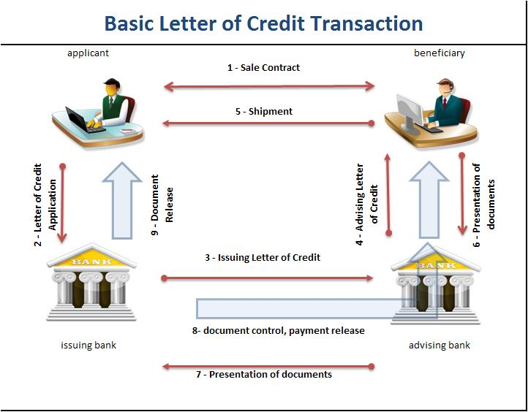
Section 4 – Letters of Credit

Slide 61
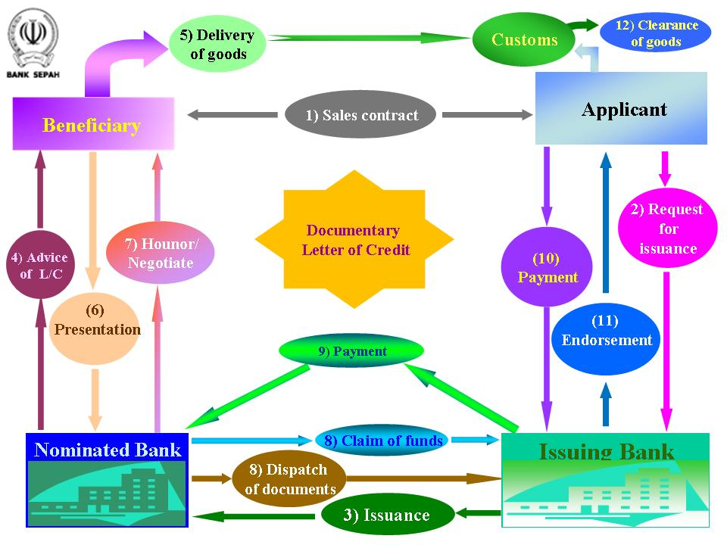
Section 4 – Letters of Credit

Slide 62
Section 4 – Letters of Credit
4. Types of Letters of Credit
Letters of credit can be quite flexible in the design and each is used for a specific purpose. Based on different classification methods, there are a number of different types of L/C which are listed in the following table.

Slide 63
Section 4 – Letters of Credit
4. Types of Letters of Credit
Classification | Types of Letters of Credit
Whether the credit can be revoked | Revocable L/C
 | Irrevocable L/C
Whether confirmed by another bank | Confirmed L/C
 | Unconfirmed L/C
According to the mode of availability | Sight Payment L/C
 | Acceptance L/C

Slide 64
Section 4 – Letters of Credit
4. Types of Letters of Credit
Classification | Types of Letters of Credit
Whether the credit can be transferred | Transferable Credit
 | Non-transferable Credit
According to special function clauses added | Red Clause Credit
 | Green Clause Credit
 | Standby Credit
 | Back-Back Credit
 | Reciprocal Credit
 | Revolving Credit
(Case 6-9)

Slide 65
Section 4 – Letters of Credit
5. Electronic Applications for Documentary Credits
Buyers install software in their office PCs that enable them to fill out an application and send it via modem to the bank processing centers. Electronic applications enable the repeat letter of credit applicant faster turnaround and cut paperwork for the bank.

Slide 66
Section 4 – Letters of Credit
5. Electronic Applications for Documentary Credits
Fraud
Many of the opportunities for fraud center around the fact that banks deal in documents and not goods, and therefore the seller has the opportunity for presenting fraudulent documents.

Slide 67
Section 4 – Letters of Credit
5. Electronic Applications for Documentary Credits
Payment Clause
Barriers to Electronic Payments: trust and security.
As trust and security issues a re resolved – as they continue to be each day – companies around the world will add the software tools required to conduct their business on-line.

Slide 68
The End
Thanks!

